Slide 1
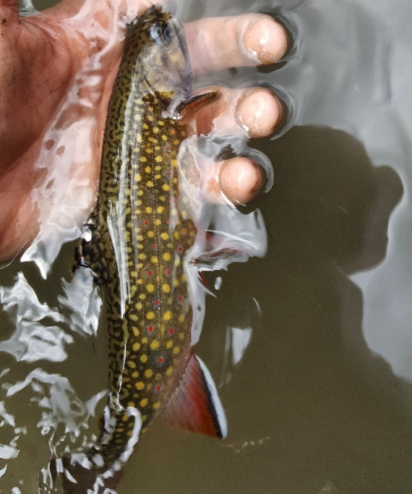




Brook Trout Occupancy Modeling
Brett Kelly¹, Michael Siepker², and Michael J. Weber¹
¹Iowa State University, ²Iowa Department of Natural Resources

Slide 2
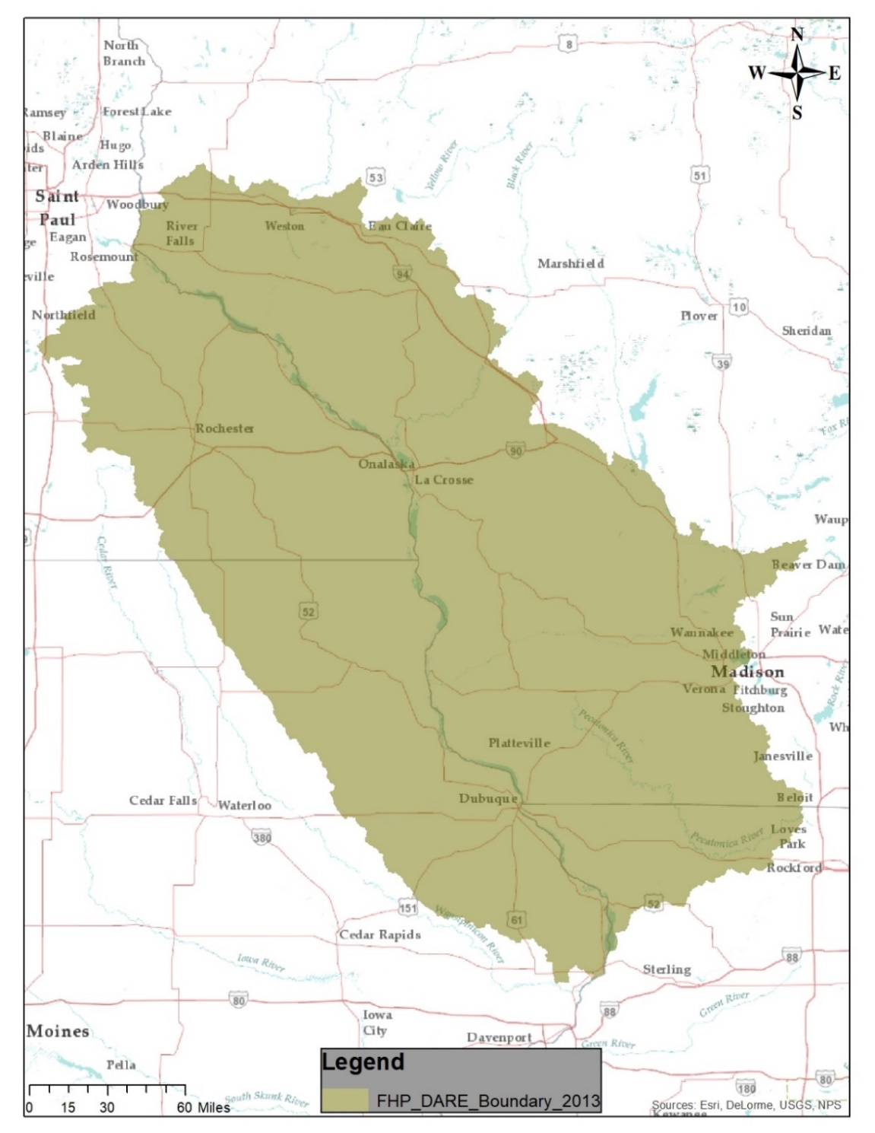
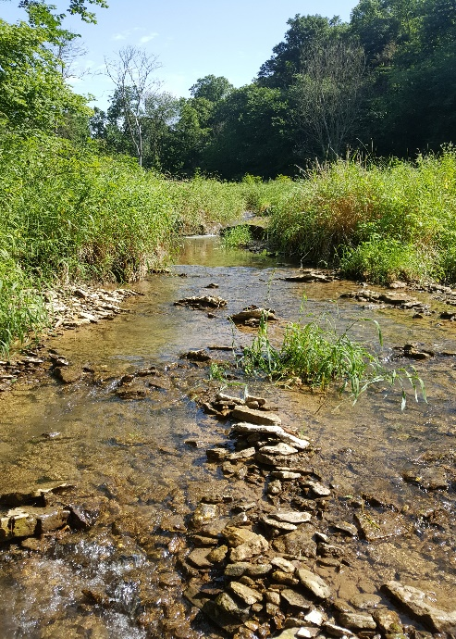
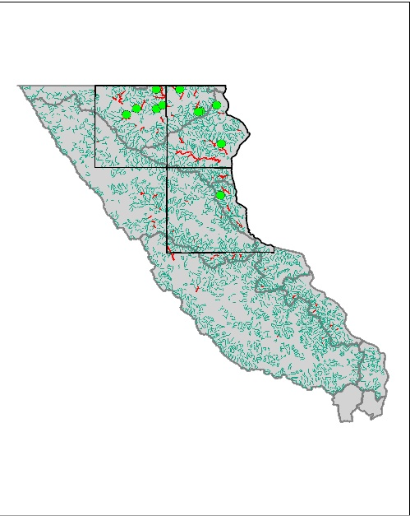
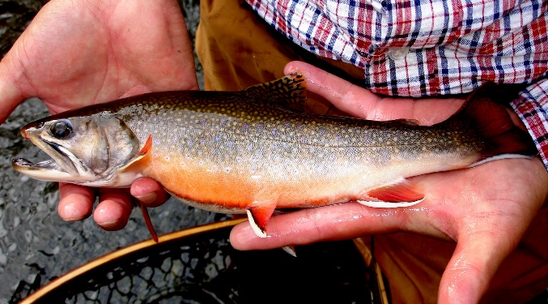
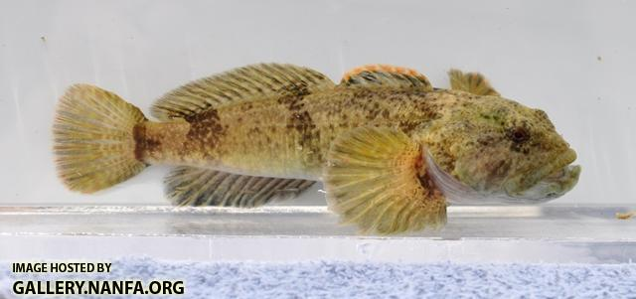
Status and Distribution
Within Iowa’s portion of the Driftless Area, what does the spatial distribution of Brook and Brown trout look like?
Can associations with in-stream habitat parameters and presence/absence be made?
Iowa DNR and USFWS
Census of stream fishes in headwaters of NE Iowa
Driftless Area Ecoregion
Coldwater systems and SGCN

Slide 3
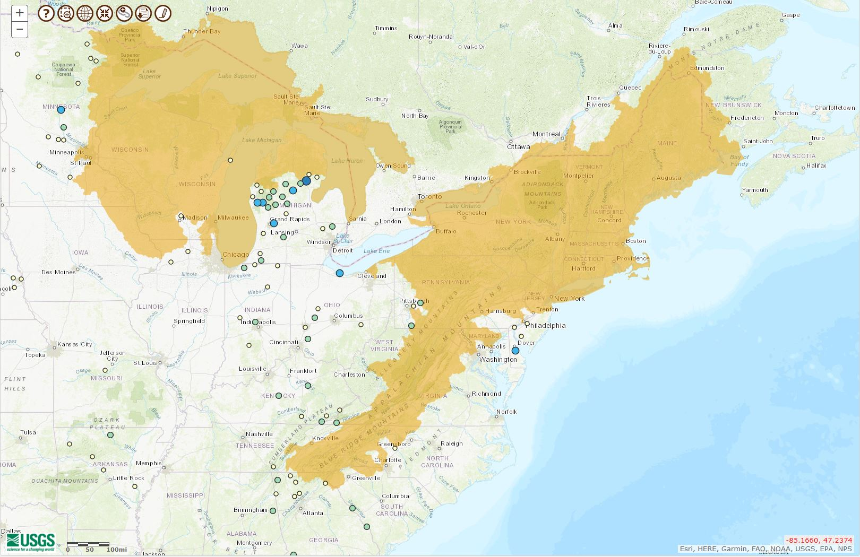
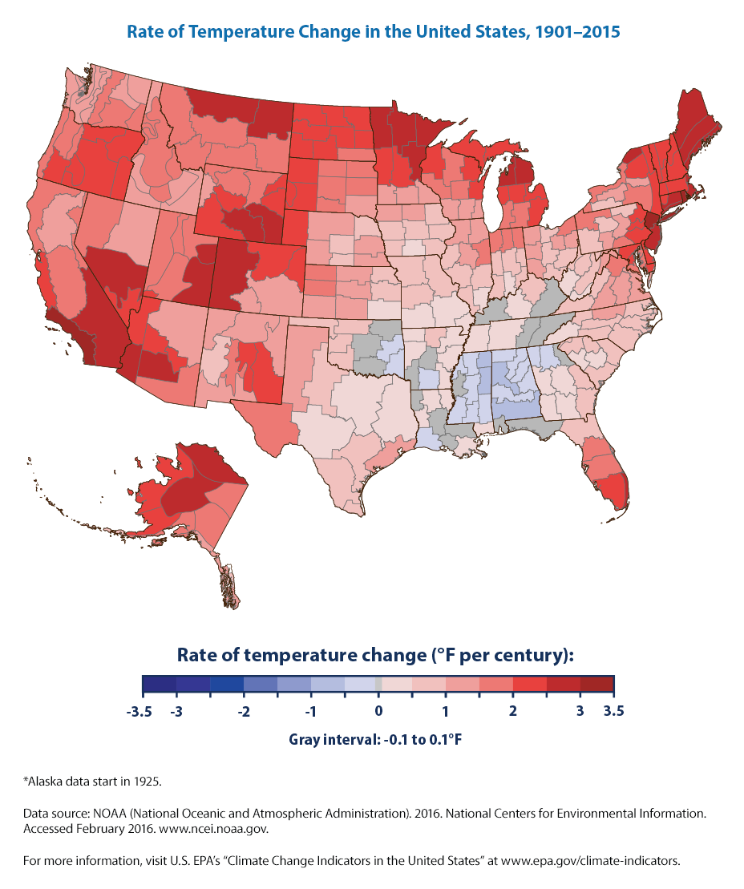
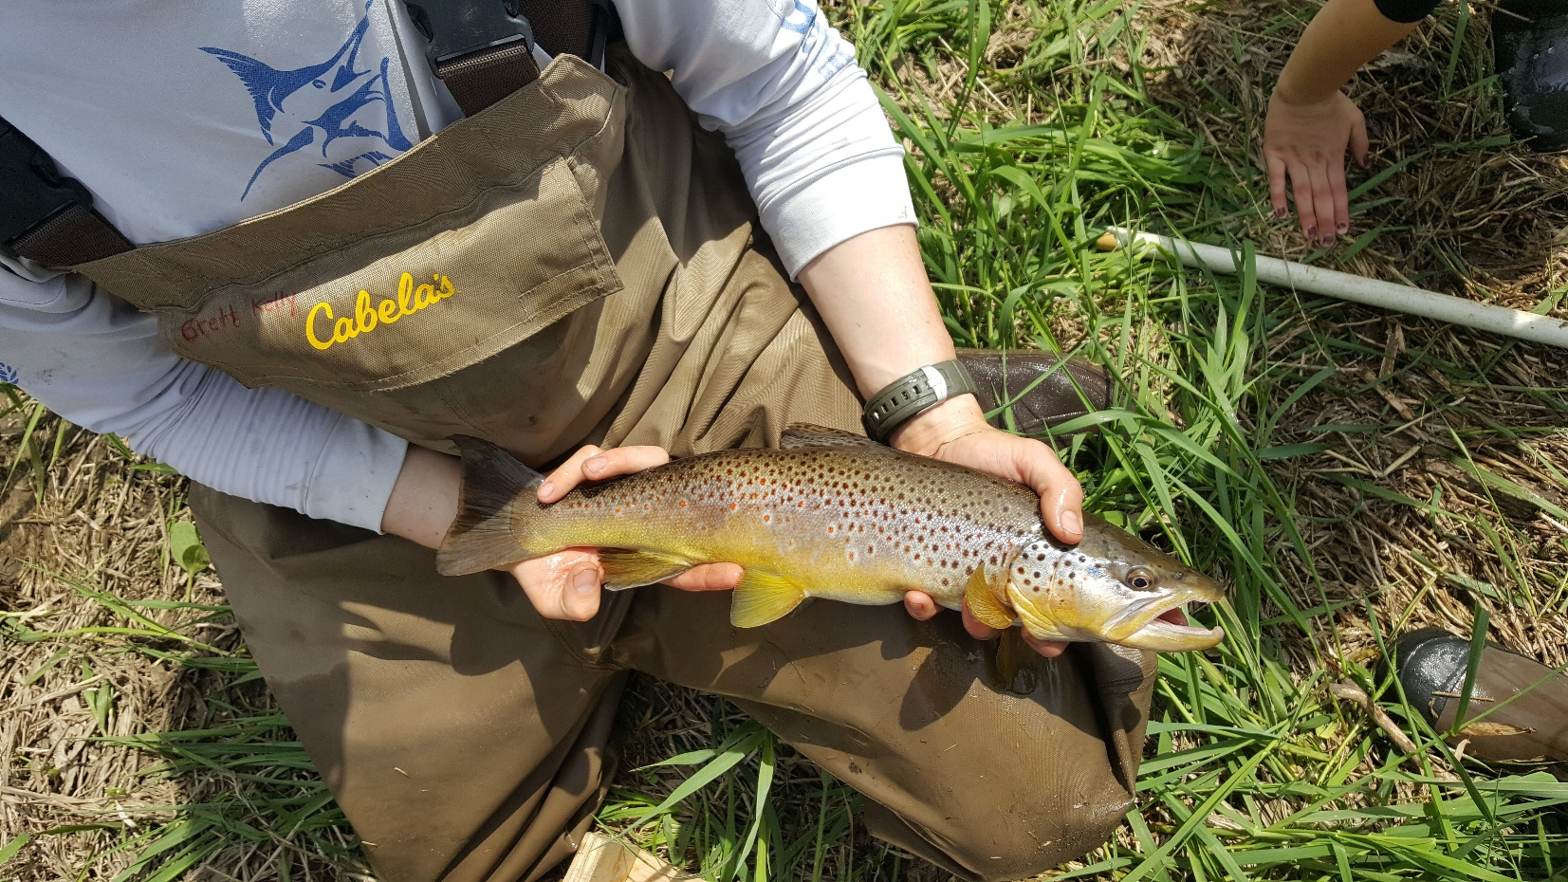
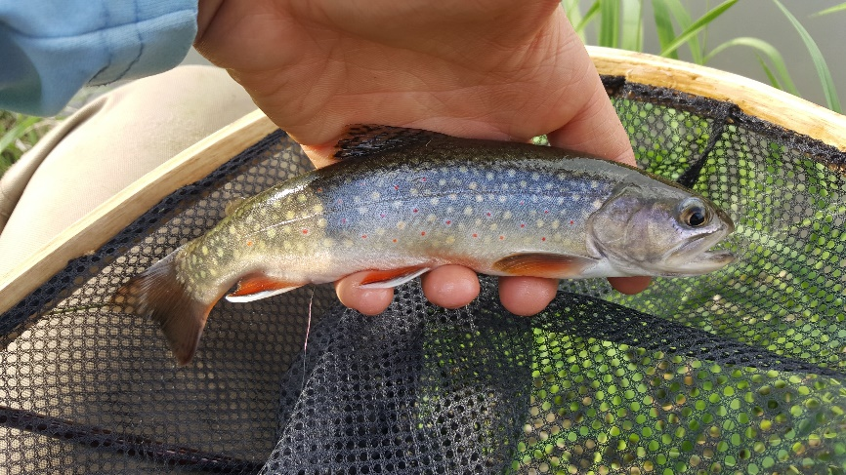
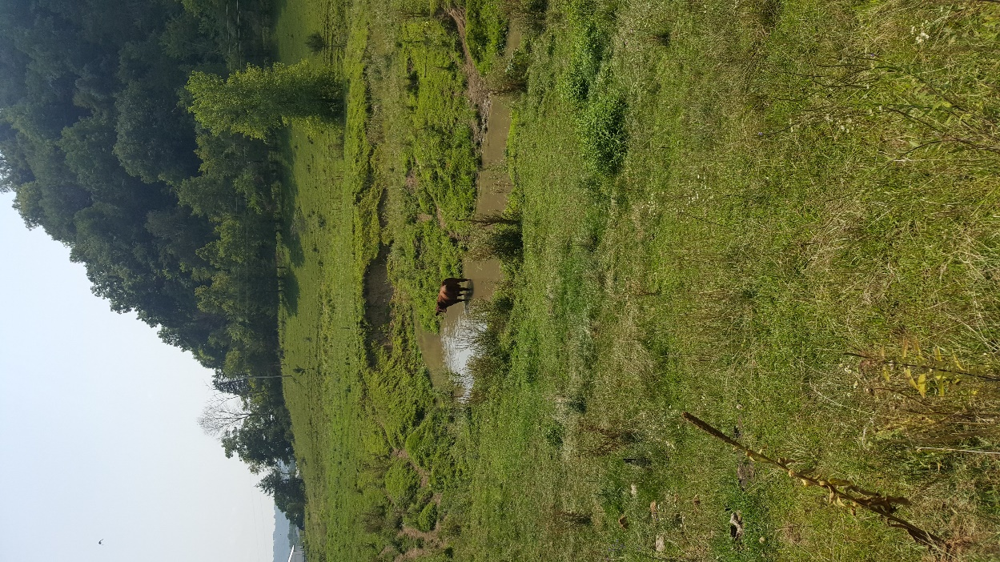
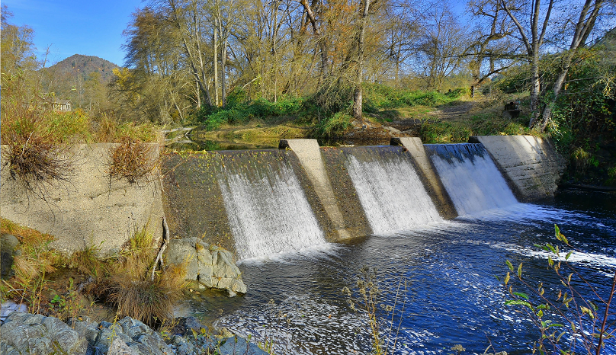
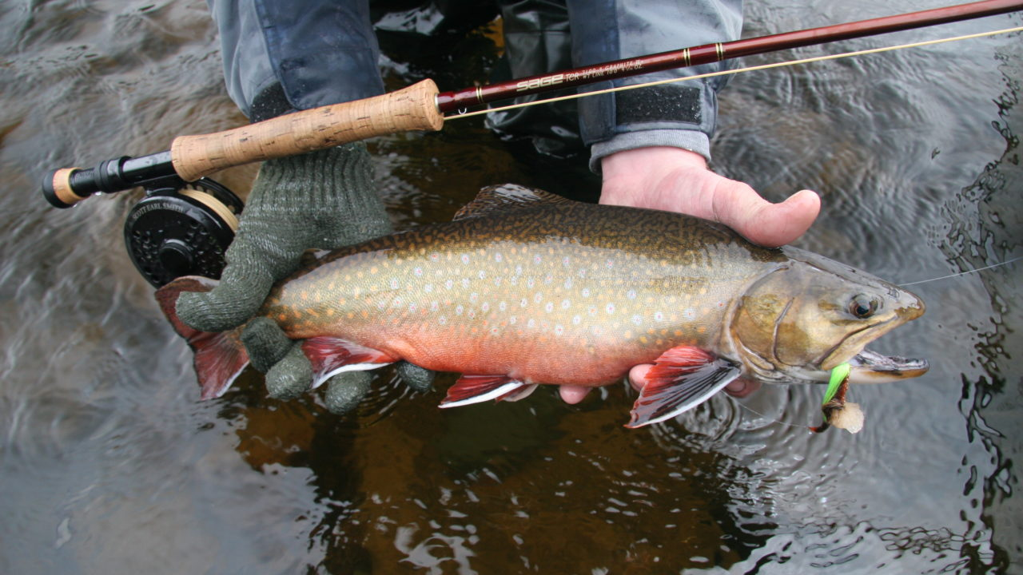
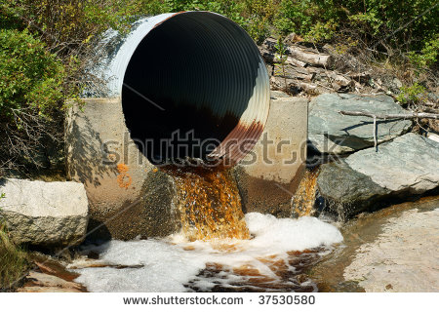
Project Purpose and importance

Slide 4
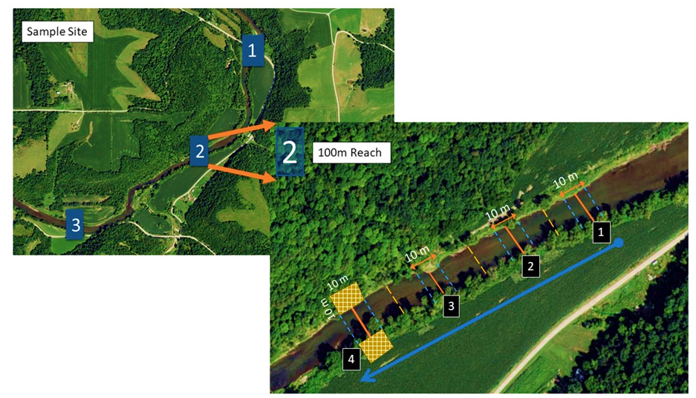
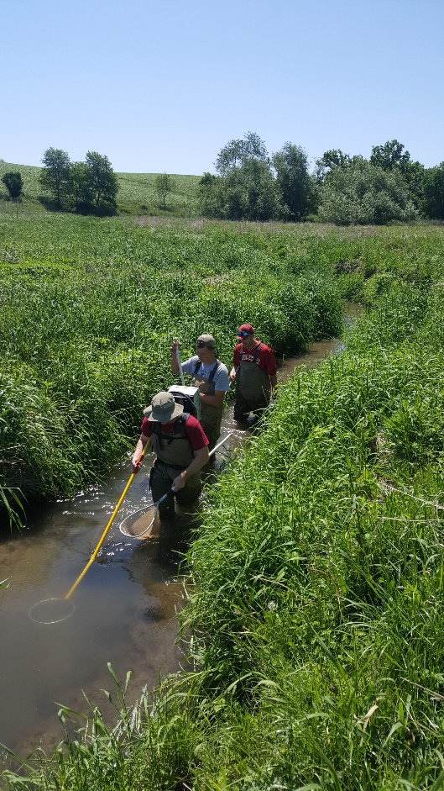
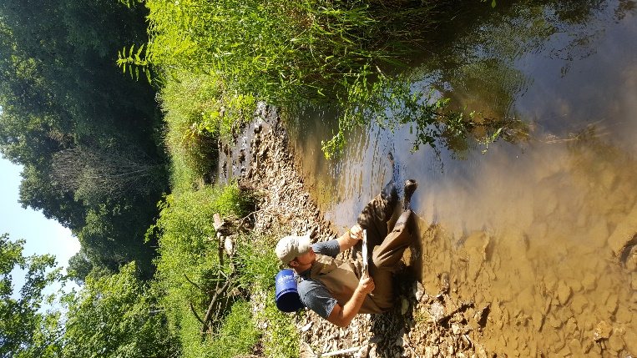
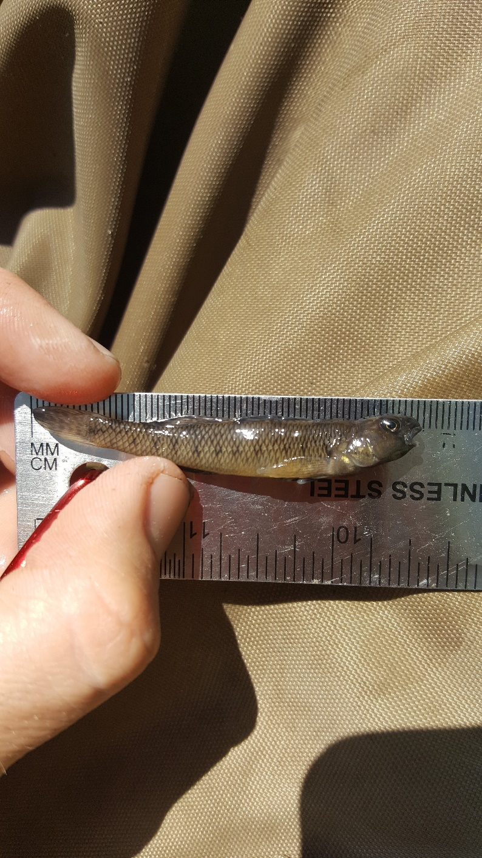
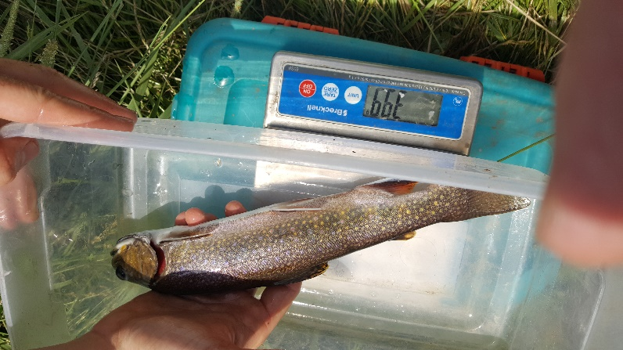

Slide 5
Analysis Methods: Occupancy Modeling
Response
Predictor(s)
Occupancy (Psi):
Proportion of sample units occupied
probability that a site is occupied (ranges from 0-1)
Detection Probability (p): probability of detecting the species in site i at time j, given species presence
Site Level Covariates
Specific to the “site” which you did your sampling (average stream depth, % canopy cover, etc.)
Observation Level Covariates
Specific to the replicate observation or sampling occasion (weather, turbidity, etc.)

Slide 6
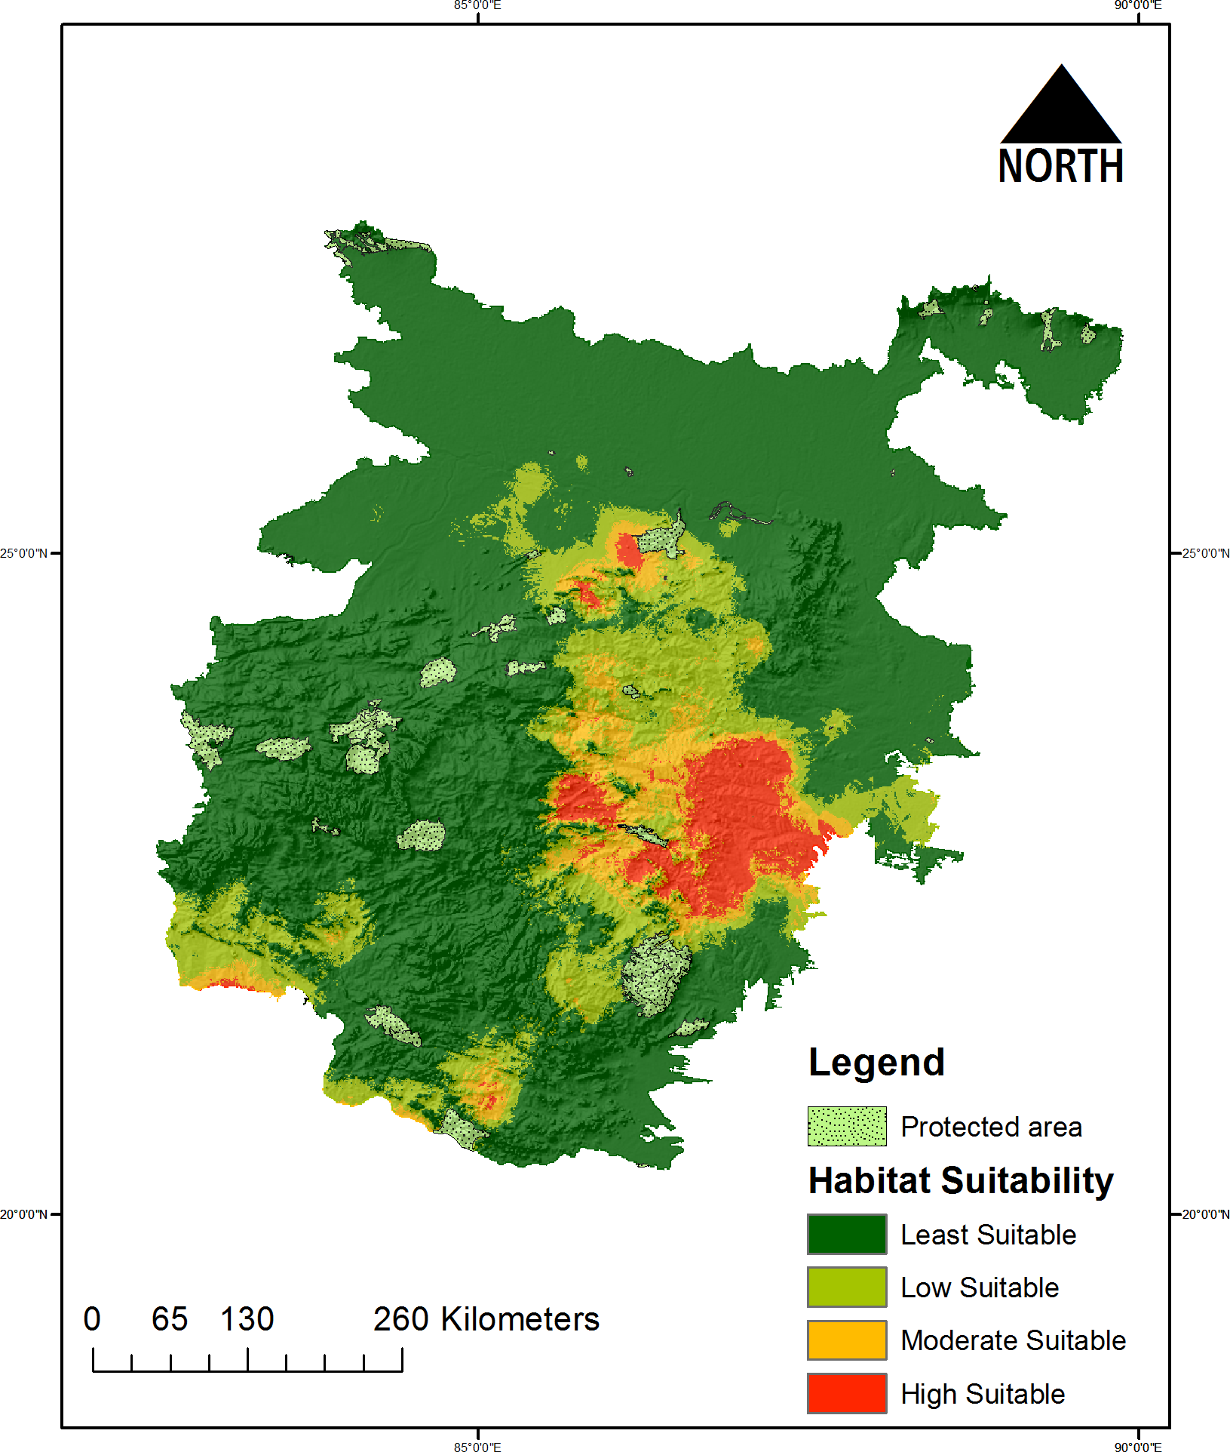
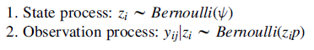
Observational Study:
Response the function of environmental covariates
Responses: on probability scale (0-1), need glm, logistic regression
Occupancy Framework: ML function with two submodels

Slide 7

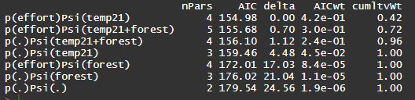
Analyses ran in package ‘unmarked’
Fit occupancy models (logistic regression) as functions of environmental covariates
Model selection based on AICc (information theoretic approach)

Slide 8
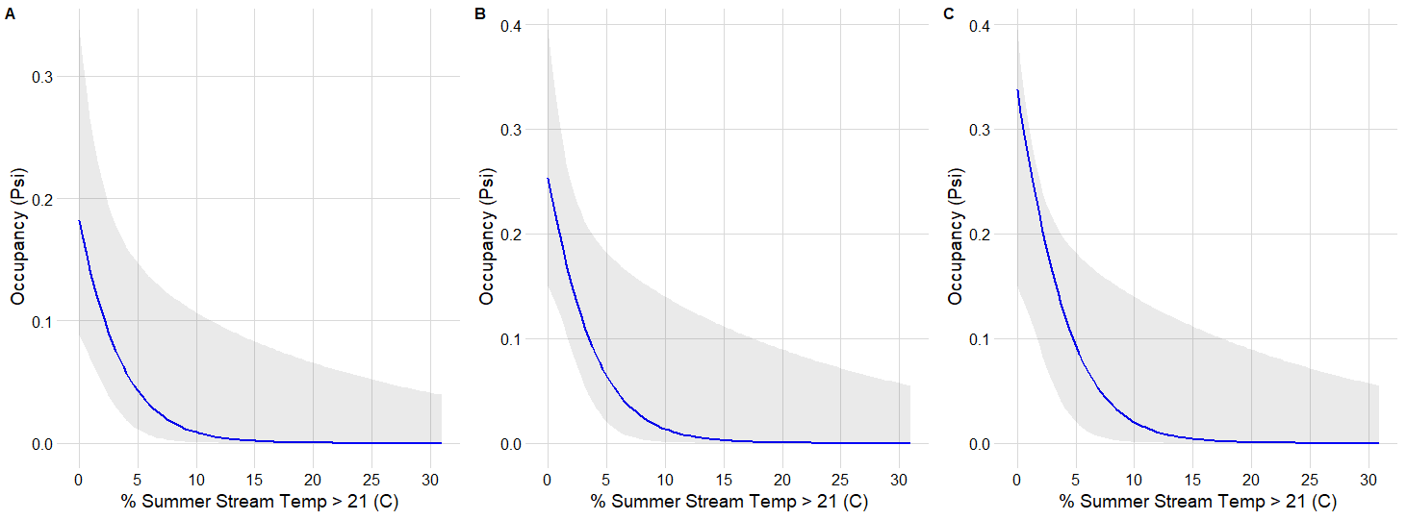
Results

Slide 9
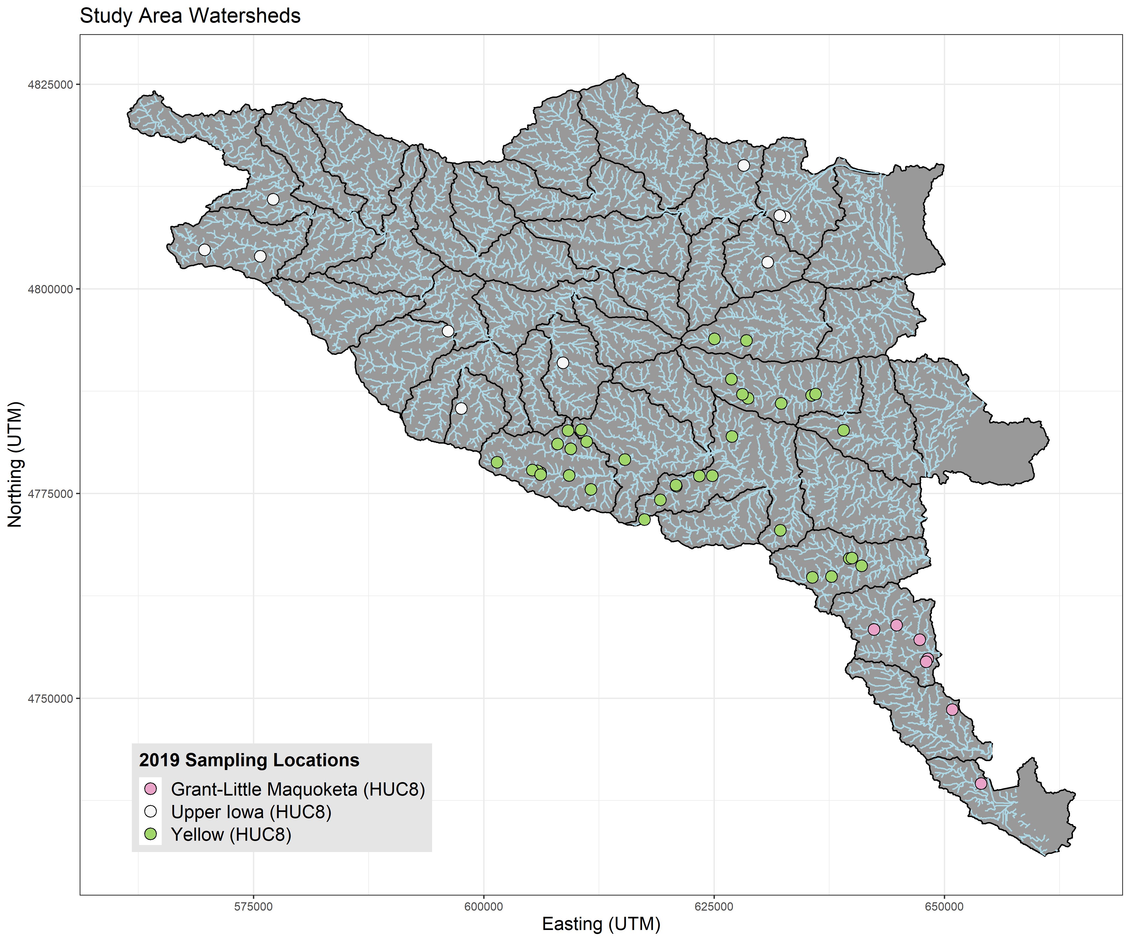
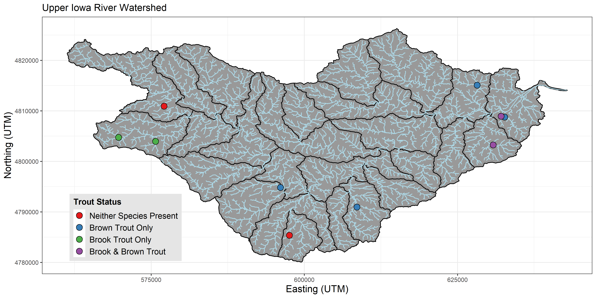
Who Cares bro?

Slide 10
